Slide 1
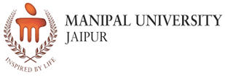
School of Computer Science and Engineering (CSE and IT)
Department of Information Technology
Minor Project Presentation
On
TITLE: OptiBrainGAN: GAN generated MRI Data and Metaheuristic-Optimized
Deep Learning Models for Alzheimer’s Stage Progression and Classification
Presented By: Supervised By:
Student Names: Vandana, Mahika Shukla Supervisor Name: Mr. Venkatesh Gauri Shankar
Enrolment Number: 229302376, 229302464 Designation: Assistant Professor
Section: 6E Date: 17th April 2025
Panel Number: 13

Slide 2
INDEX
Introduction
Background
Related Work and Literature Review
Problem Statement
Methodology
Experimental Setup
Results
Conclusion and Future Work
Research Paper
References

Slide 3
INTRODUCTION:
Enhancing Alzheimer’s Diagnosis with GANs and Optimization
OptiBrainGAN leverages Generative Adversarial Networks (GANs) to generate high-quality synthetic MRI data, addressing data scarcity and improving deep learning model performance for Alzheimer’s stage classification.
Additionally, it integrates metaheuristic optimization techniques to fine-tune model parameters, enhancing accuracy, generalization, and reducing overfitting.
OptiBrainGAN improves feature extraction and classification reliability. This approach not only strengthens early diagnosis but also aids clinical decision-making, making it a valuable tool for Alzheimer’s disease management.
By optimizing deep learning architectures and enriching training datasets, it ensures more robust and scalable models for real-world applications.

Slide 4
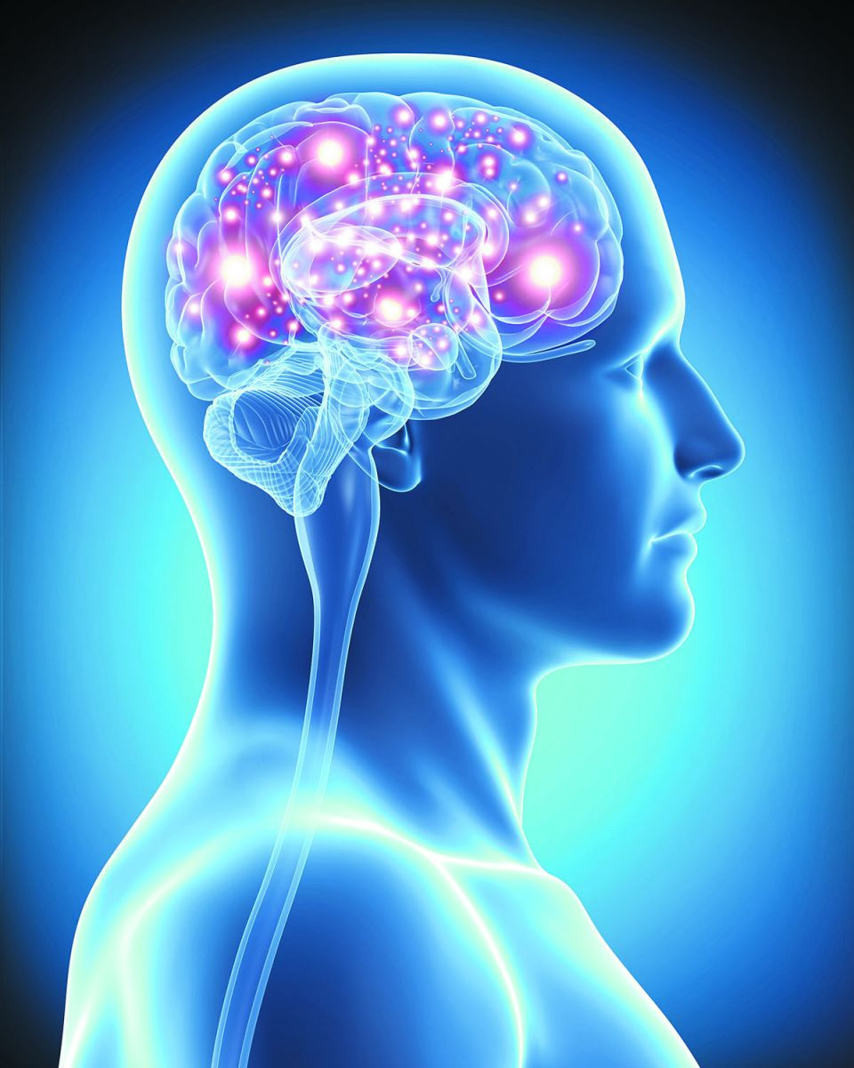
Background
Alzheimer’s Disease (AD) is a progressive neurodegenerative disorder that leads to cognitive decline, memory impairment, and structural brain changes.
Early diagnosis and accurate staging of AD are critical for timely intervention and patient management. MRI scans play a central role in Alzheimer’s research.
However, the scarcity of labeled MRI datasets poses a challenge for deep learning-based diagnostic systems. Synthetic data generation through Generative Adversarial Networks (GANs) can mitigate this issue by generating diverse, high-quality MRI images.
Additionally, metaheuristic algorithms, known for solving optimization problems efficiently, can be employed to optimize deep learning hyperparameters, thus improving model performance.

Slide 5
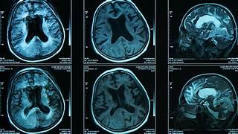
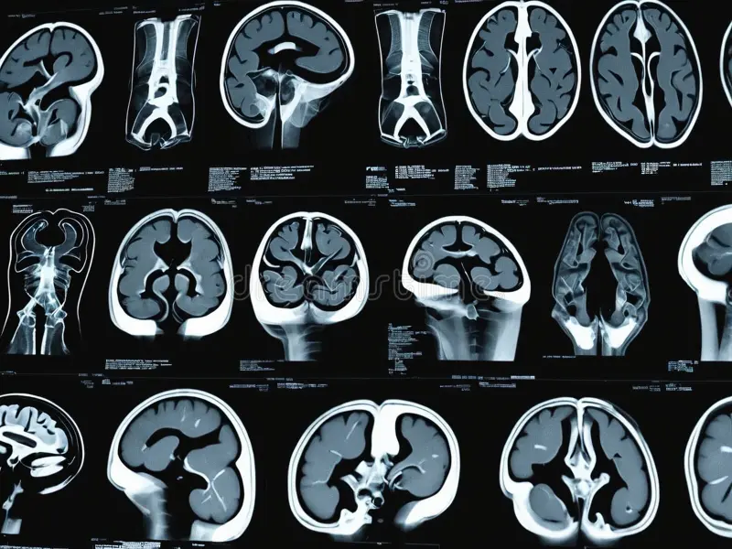
RELATED WORK AND LITERATURE REVIEW
Deep Learning for Alzheimer’s Diagnosis
Several deep convolutional neural network (CNN)-based architectures have been proposed for classifying Alzheimer’s disease stages.
Models like Inception V3, MobileNet, DenseNet, and EfficientNet have shown promise due to their capacity to learn hierarchical spatial features from MRI data.
2. GANs in Medical Imaging
GANs have been widely used in medical imaging to generate synthetic data, enhance image resolution, and perform image-to-image translation tasks. Studies have demonstrated the effectiveness of GANs in generating realistic MRI scans, which can address the issue of small datasets and prevent overfitting in deep learning models.
MedGAN and DAGAN are examples of GANs developed specifically for healthcare data generation, including MRI and CT images.
Conditional GANs (cGANs) have also been explored for generating MRI scans conditioned on specific brain characteristics, aiding in disease progression modeling.

Slide 6
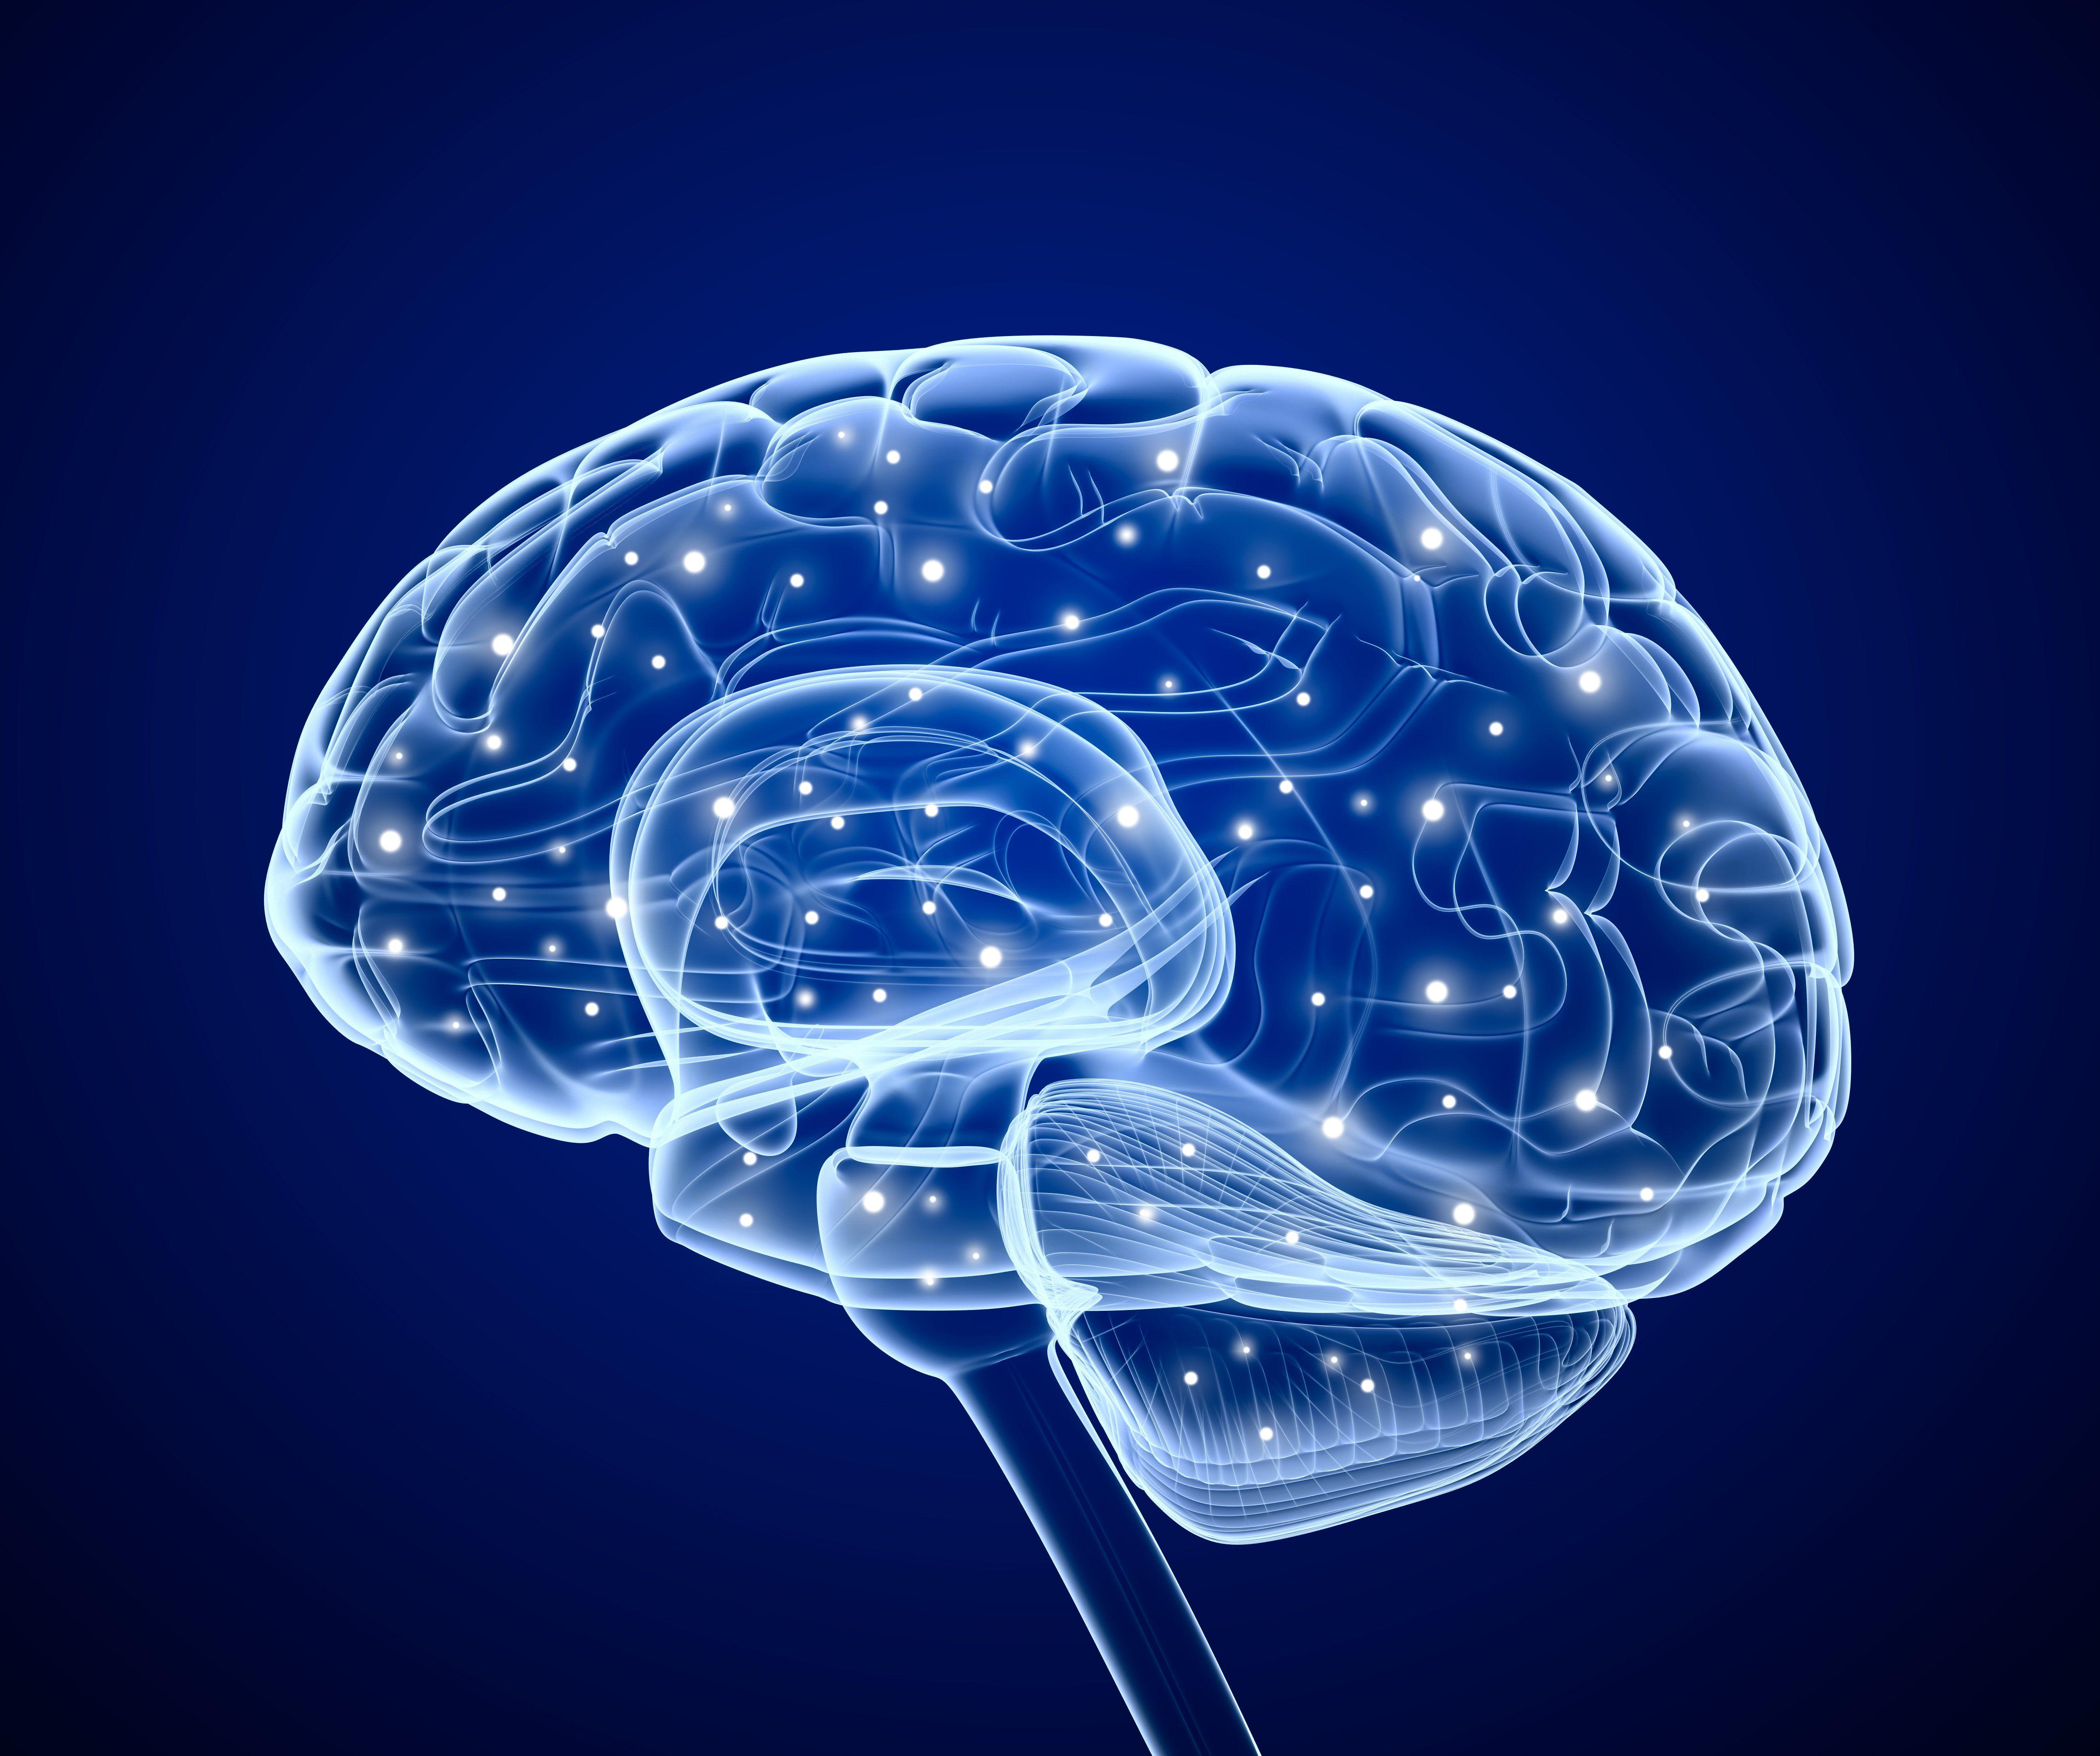
3. Optimization Techniques in Deep Learning
Metaheuristic algorithms such as Genetic Algorithms (GA), Particle Swarm Optimization (PSO), and Differential Evolution (DE) are gaining traction in optimizing hyperparameters of deep learning models.
These algorithms can navigate complex search spaces efficiently, reducing the need for exhaustive manual tuning.
Most studies do not integrate systematic optimization with deep learning for Alzheimer’s classification.
4. Limitations in Existing Approaches
Data scarcity and imbalance limit model performance.
Training deep models is computationally expensive.

Slide 7
Alzheimer’s MRI Datasets : Publicly available datasets like the Alzheimer’s Disease Neuroimaging Initiative (ADNI) and OASIS have been instrumental in training and evaluating deep learning models for AD diagnosis and staging.
In our project we have taken data from ADNI. Studies utilizing the ADNI dataset have focused on classifying Alzheimer’s progression from cognitively normal (CN) to mild cognitive impairment (MCI) and Alzheimer’s disease (AD).
Data preprocessing techniques, such as skull stripping, bias field correction, and intensity normalization, are commonly applied to MRI scans to improve model robustness.

Slide 8
GAN Applications in Alzheimer’s Research : Researchers have applied GANs to generate synthetic MRI data, augment existing datasets, and reduce class imbalance. GAN-based data augmentation has been shown to improve Alzheimer’s classification accuracy by diversifying training samples.
Optimization Techniques in Alzheimer’s Classification : Metaheuristic optimization techniques have been used to enhance the accuracy of deep learning models.
A combination of GAN-generated data and metaheuristic-optimized models can potentially address the challenges of limited datasets and overfitting.

Slide 9
PROBLEM STATEMENT:
Accurate classification of Alzheimer’s disease (AD) stages remains a significant challenge due to the difficulty in identifying early-stage symptoms, data scarcity, and the presence of redundant features that reduce model efficiency.
There is a need for an optimized approach that enhances Alzheimer’s classification by integrating synthetic MRI data generation and metaheuristic optimization techniques.
The primary challenge is to develop a model that can effectively extract discriminative features, reduce redundancy, and improve classification accuracy while handling data limitations.
OptiBrainGAN aims to address these issues by combining GAN-generated MRI scans with optimized deep learning architectures to improve Alzheimer’s disease stage classification and progression analysis.

Slide 10
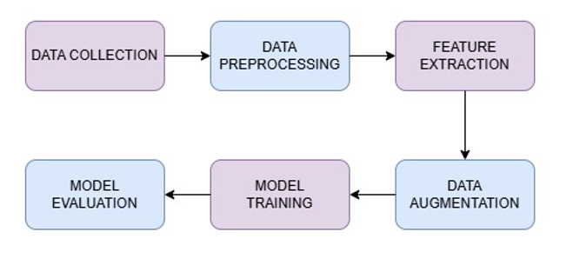
METHODOLOGY A) FLOWCHART
The 2 flowcharts illustrate the detailed methodology followed for this project. It begins with data collection, followed by preprocessing to clean and standardize MRI scans. Key features are extracted using deep learning models, and data augmentation using traditional methods and Vanilla GAN which enhances dataset diversity. The augmented data is used to train optimized deep learning models, and the final step involves evaluating model performance.

Slide 11
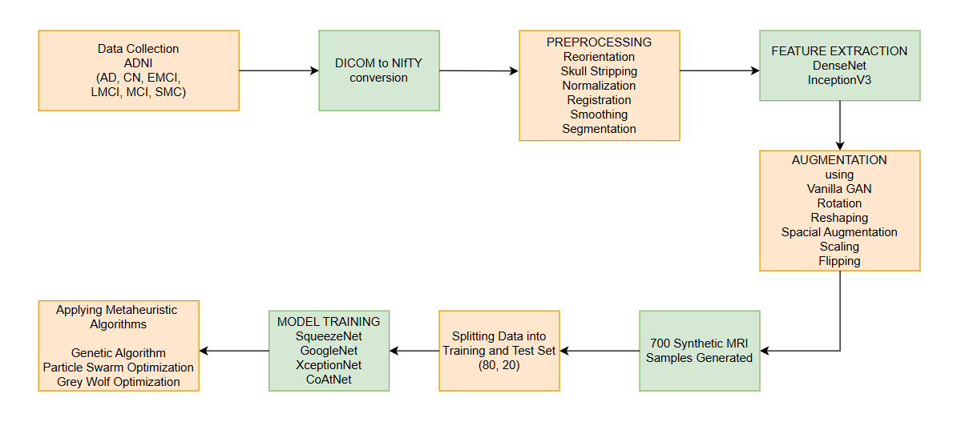
b) Architectural diagram

Slide 12
EXPERIMENTAL SETUP:
1. Hardware Setup:
Processor: High-performance GPU
RAM: 32GB or higher
Storage: SSD with at least 1TB capacity
Frameworks: TensorFlow, PyTorch
Libraries: NumPy, Pandas, SciPy, Scikit-learn
2. Dataset Used:
Source: ADNI(Alzheimer’s Disease Neuroimaging Initiative)
Data Type: Axial (horizontal cross-section of the brain) MRI Scans (T1 and T2-weighted images) (T1 is used to measure brain volume and detect brain atrophy, particularly in the hippocampus while T2 is for detecting white matter hyperintensities).
Classes: AD (Alzheimer’s Disease), CN (Cognitively Normal), EMCI (Early Mild Cognitive Impairment), LMCI (Late Mild Cognitive Impairment), MCI (Mild Cognitive Impairment), SMC (Subjective Memory Concern)
Preprocessing:
Reorientation (Adjusting MRI images to follow a standard orientation),
Skull Stripping (Removing non-brain tissues such as the skull, scalp, and fat from the MRI image i.e. reducing noise),
Normalization (Mapping the MRI image to a standard brain template), Registration (Aligning images to a standard template),
Smoothing (reduce noise and improve signal-to-noise ratio),
Segmentation (Dividing the brain MRI into different regions/tissue types like gray matter, white matter and cerebrospinal fluid).

Slide 13
3. Model Training & Optimization:
Feature Extraction: IncevptionV3 and DenseNet- InceptionV3 is a deep convolutional neural network known for its Inception Modules, which apply multiple filter sizes (1x1, 3x3) in parallel. This helps capture both fine-grained and large-scale features in MRI scans, it reduces computational costs while maintaining high performance. DenseNet (Dense Convolutional Network) connects each layer to every other layer, which enhances feature reuse and strengthens gradient flow during backpropagation. It prevents feature redundancy and overfitting.
Data Augmentation: Traditional methods like Rotation, Flipping and Scaling, Applying Vanilla GAN – Rotation makes the model robust to orientation changes, Flipping helps the model learn symmetrical brain features and avoid bias toward one side of the brain and Scaling helps the model handle variations in brain size. Vanilla GAN is the simplest form of GAN consisting of two neural networks Generator that creates synthetic images and Discriminator that distinguishes between real and synthetic MRI scans.
Model Training using SqueezeNet, GoogleNet, XceptionNet, CoAtNet.
SqueezeNet – It is a lightweight CNN that uses Fire modules (which include 1x1 and 3x3 filters) to reduce the number of parameters while maintaining accuracy.
GoogleNet - It is a deep CNN based on the Inception module, which uses multiple filter sizes (1x1, 3x3, 5x5) in parallel to extract features at different scales.
XceptionNet - It is an improvement over InceptionNet, based on depthwise separable convolutions, which split spatial and depth-based feature extraction.
CoAtNet - It combines the strengths of CNNs and Transformers by merging convolutional layers (for local feature extraction) with attention mechanisms (for capturing long-range dependencies), can help improve classification performance by extracting both detailed local brain features and large scale global features.

Slide 14
Training: 80% training, 20% validation split
Optimization Algorithms: Metaheuristic techniques (Genetic Algorithm, Particle Swarm Optimization & Grey Wolf Optimization)
Genetic Algorithm (GA): Inspired by natural selection, GA evolves a population of potential solutions using operations like selection, crossover, and mutation. Over generations, it optimizes hyperparameters by retaining the fittest solutions.
Particle Swarm Optimization (PSO): PSO mimics the behavior of a swarm. Each solution moves through the search space by updating its position based on its own best performance and the swarm’s best-known position, helping find optimal model parameters efficiently.
Grey Wolf Optimization (GWO): Inspired by the leadership hierarchy and hunting behavior of grey wolves, GWO simulates alpha, beta, delta, and omega roles to guide the search process. It balances exploration and exploitation by encircling prey and updating positions based on the top three best solutions.
4. Performance Evaluation Metrics:
Accuracy, Precision, Recall, F1-Score, AUC-ROC, Confusion Matrix, PR Curve

Slide 15
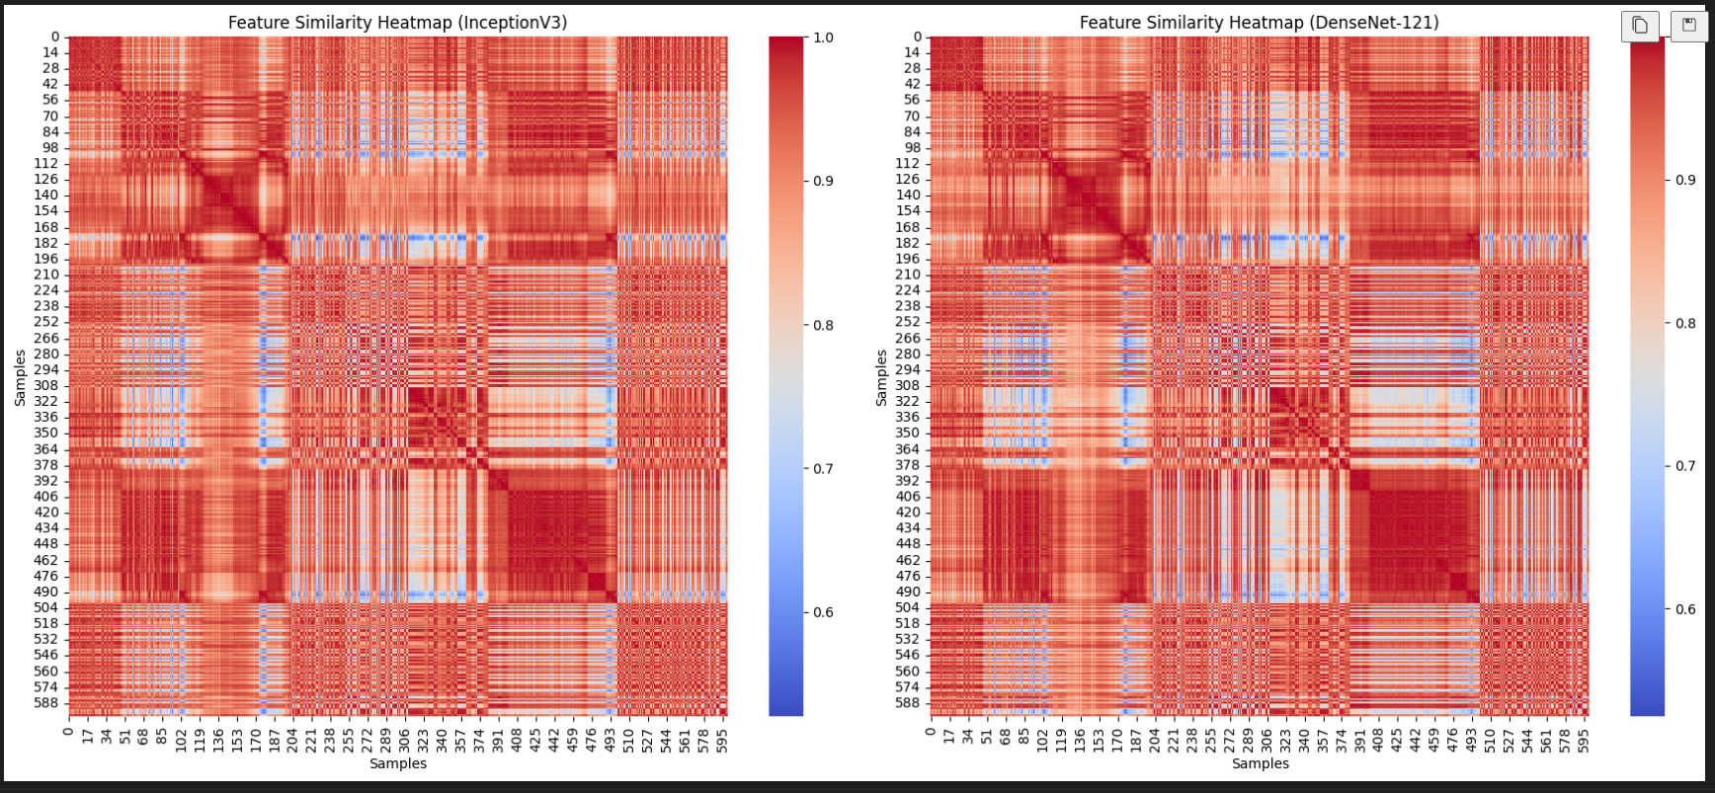
Results
Heatmap obtained after Feature Extraction using IncevptionV3 and DenseNet
Red regions(values close to 1) – Indicates high similarity between feature vectors.
Blue regions(values close to 0) – Indicates low similarity i.e. distinct features.

Slide 16
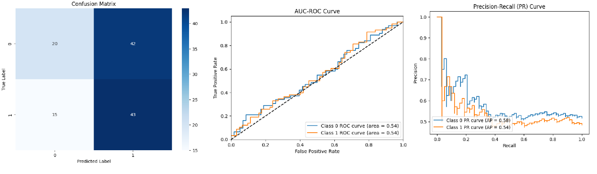
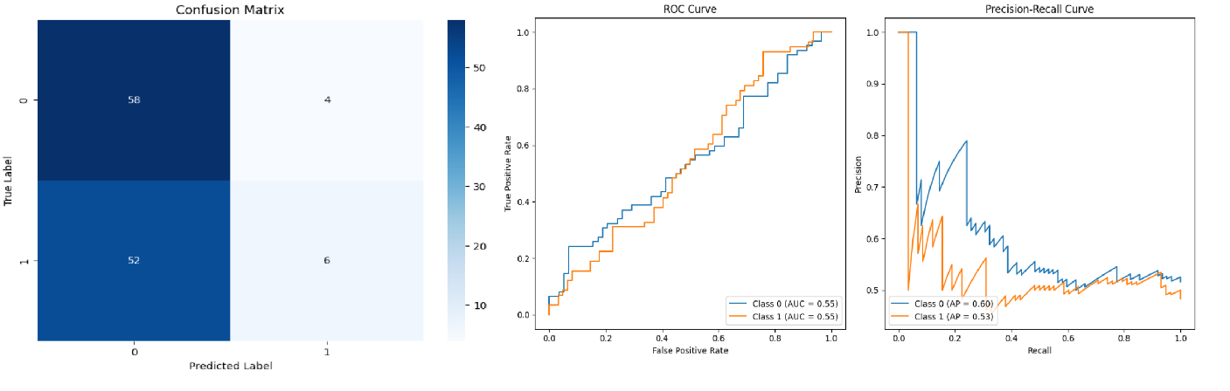
Results obtained for Model Training using SqueezeNet and GoogleNet

Slide 17
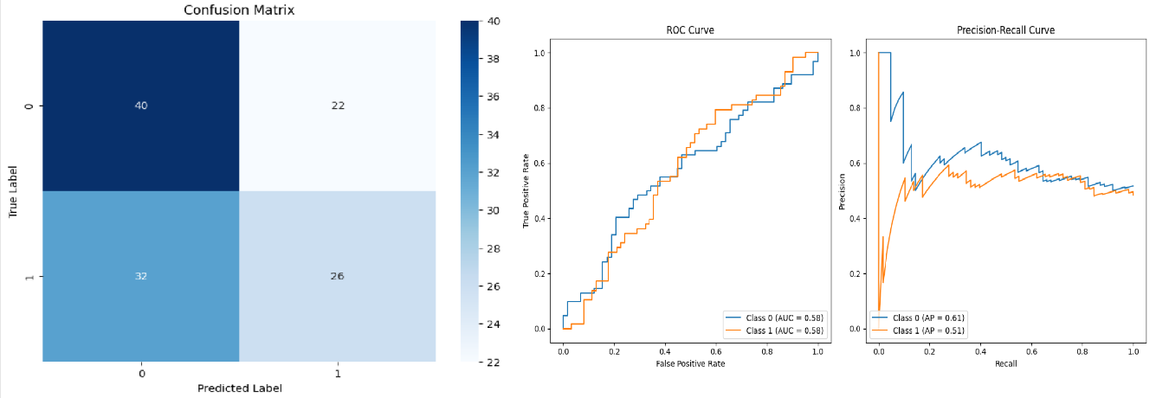
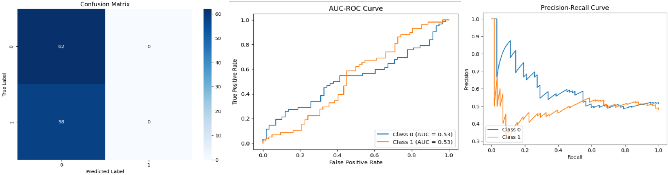
Results obtained for Model Training using XceptionNet and CoAtNet

Slide 18
RESULTS OBTAINED FROM MODEL TRAINING BEFORE APPLYING GAN
Model | Precision(%) | Recall(%) | F1 Score(%) | Accuracy(%)
SqueezeNet | 27 | 52 | 35 | 52±0.8
GoogleNet | 23 | 48 | 31 | 48±0.4
XceptionNet | 23 | 48 | 31 | 48±0.7
CoAtNet | 23 | 48 | 31 | 48±0.5
The best accuracy obtained was 52% using SqueezeNet Model.

Slide 19
RESULTS OBTAINED FROM MODEL TRAINING AFTER APPLYING GAN
Model | Precision(%) | Recall(%) | F1 Score(%) | Accuracy(%)
SqueezeNet | 28 | 53 | 37 | 53±0.9
GoogleNet | 28 | 53 | 37 | 53±0.7
XceptionNet | 63 | 56 | 45 | 56±0.9
CoAtNet | 28 | 53 | 37 | 53±0.9
The best accuracy obtained was 56% using XceptionNet model.

Slide 20
Results obtained by applying Metaheuristic Algorithms
Model | Precision(%) | Recall(%) | F1 Score(%) | Accuracy(%)
Genetic Algorithm | 96.72 | 95.43 | 96.01 | 96
Particle Swarm Optimization | 94.3 | 94.7 | 95.52 | 95.50
Grey Wolf Optimization | 96.51 | 96.50 | 96.50 | 96.5
The best accuracy obtained was 96.5% using Grey Wolf Optimization Algorithm.

Slide 21
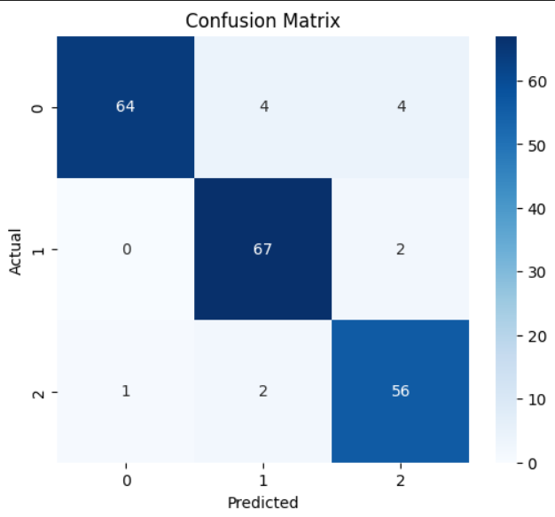
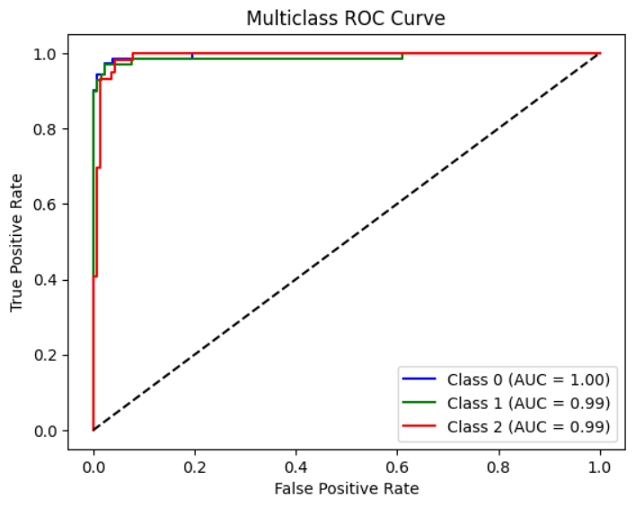
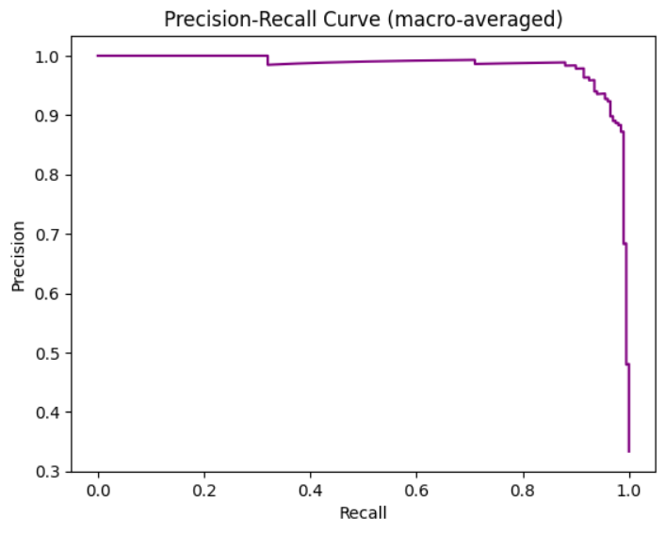
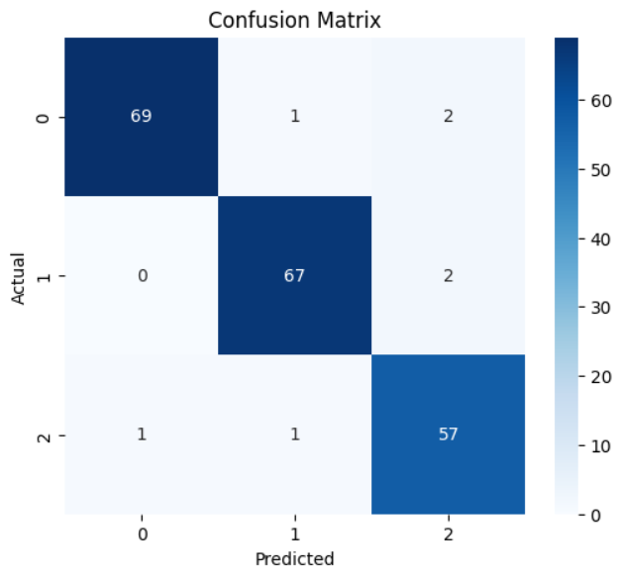
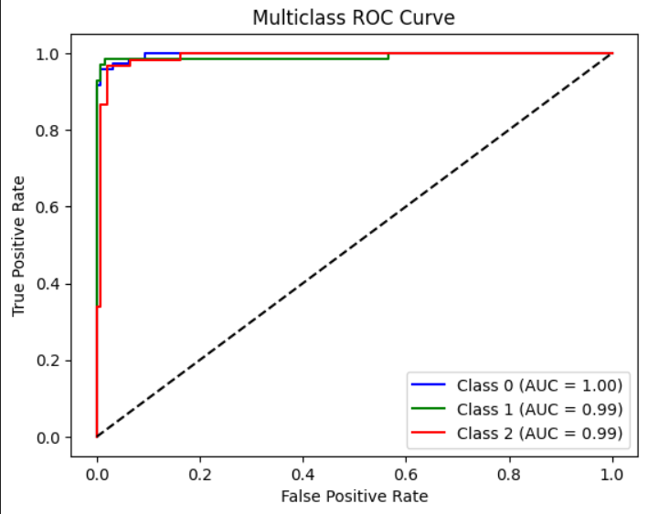
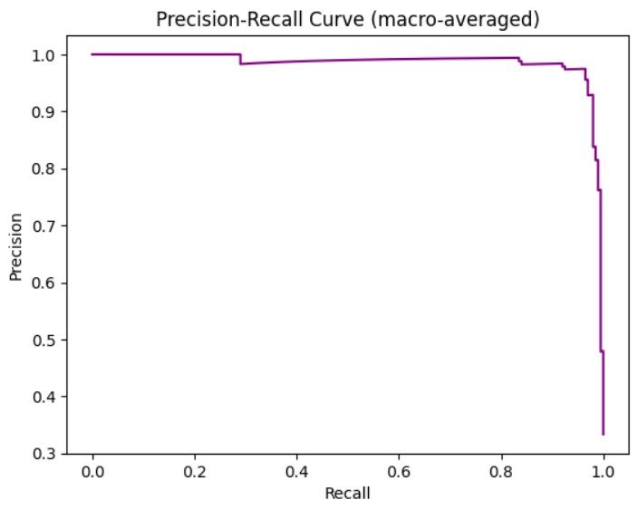
Results obtained by applying Genetic Algorithm
Results obtained by applying PSO.

Slide 22
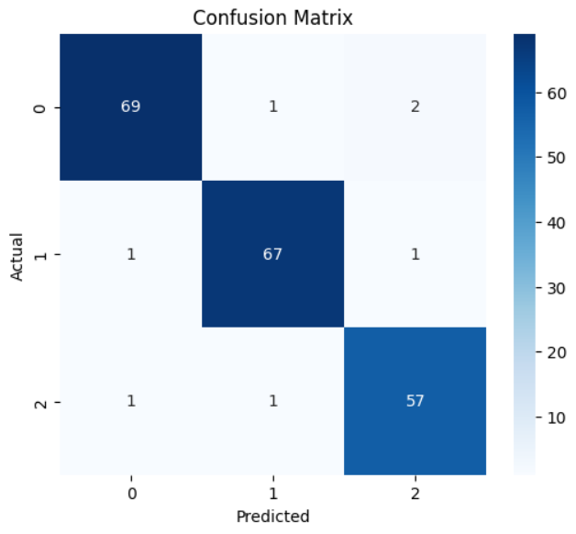
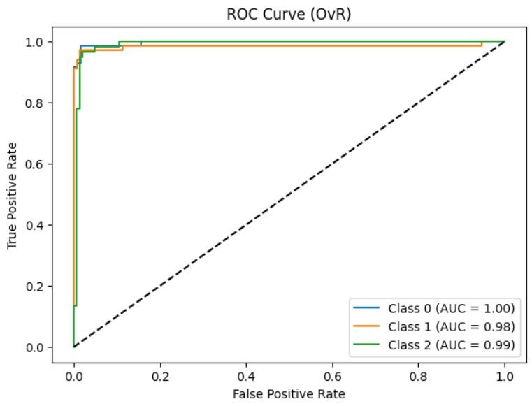
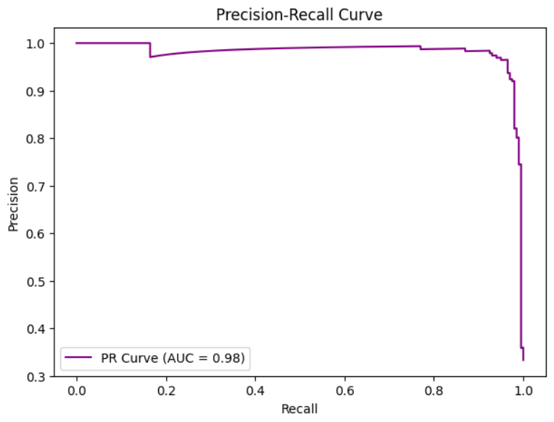
Results obtained by applying Grey Wolf Optimization Algorithm.

Slide 23
CONCLUSION
OptiBrainGAN presents a novel approach to Alzheimer’s disease classification by integrating GAN-generated MRI data augmentation with metaheuristic-optimized deep learning models. By addressing challenges such as data scarcity, feature redundancy, and computational inefficiencies, this framework enhances the accuracy and reliability of Alzheimer’s stage progression classification.
In conclusion, this research contributes to medical imaging and AI by providing an efficient and scalable solution for early-stage Alzheimer’s detection.

Slide 24
RESEARCH PAPER
OptiBrainGAN: GAN generated MRI Data and Metaheuristic-Optimized Deep Learning Models for Alzheimer’s Stage Progression and Classification (First Draft completed and submitted to Guide)

Slide 25
references
Alzheimer's Disease Neuroimaging Initiative (ADNI) dataset https://adni.loni.usc.edu/
Shankar, Venkatesh Gauri, Dilip Singh Sisodia, and Preeti Chandrakar. "An intelligent hierarchical residual attention learning‐based conjoined twin neural network for Alzheimer's stage detection and prediction." Computational Intelligence 39.5 (2023): 783-805.
Singh, Adwitiya Pratap, et al. "IHDNA: Identical Hybrid Deep Neural Networks for Alzheimer's Detection using MRI Dataset." 2023 3rd International Conference on Intelligent Communication and Computational Techniques (ICCT). IEEE, 2023.
Kishore, Nand, and Neelam Goel. "A review of machine learning techniques for diagnosing Alzheimer’s disease using imaging modalities." Neural Computing and Applications 36.35 (2024): 21957-21984.
Shankar VG, Sisodia DS, Chandrakar P. Withdrawn: A Novel Continuous-Time Hidden Markov Model Based on a Bag of Features Extracted from MR Brain Images for Alzheimer's Stage Progression and Detection Current Medical Imaging. 2025 Jan.

Slide 26
Thank you
Presented By-
Vandana (229302376 )
Mahika Shukla (229302464)

